Slide 1

Dr. Alessandra Rizzardi
Attività di Orientamento - Laboratorio IoT
Corso di Studio di Informatica
Dipartimento di Scienze Teoriche e Applicate - Università degli Studi dell’Insubria
15 Febbraio 2022

Slide 2
Internet of Things
Smart monitoring and control applications
Different technologies, services, and standards
Large-scale deployments
Continuously increase of M2M/IoT connections
Shifting from the actual vertical and fragmented deployments to a global horizontal platform
Security and privacy issues

Slide 3



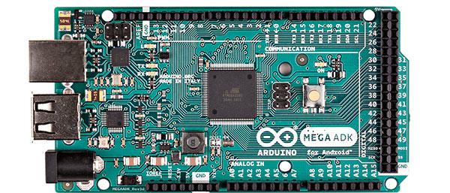
HW & SW
Program Logic
We simulate this via code!
Hardware

Slide 4
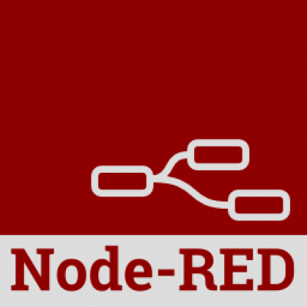

Node-RED
Visual tool for wiring the Internet of Thing, but also a generic event-processing engine
Browser-based flow editor
Flow-based programming
Use of “black-boxes”
Implemented by the IBM Emerging Technology organization
Built on Node.js

Slide 5
Why Node-RED
One-size-fits-all solution
Tool for coordinating events
Rapid prototyping
API for integration with many systems
Saving time

Slide 6
Node-RED applications
Status of processes
Alerts from machines
IoT information acquiring (e.g., temperature, weather, lights, doors, and so on)
Social or business events

Slide 7
Node-RED functionalities
The IoT service allows to register and connect different types of devices
After this the incoming and outgoing HTTP/MQTT/… nodes can be used in the flows
Different storage systems may be adopted
JavaScript functions can be created within the editor
Usable also with social networks

Slide 8
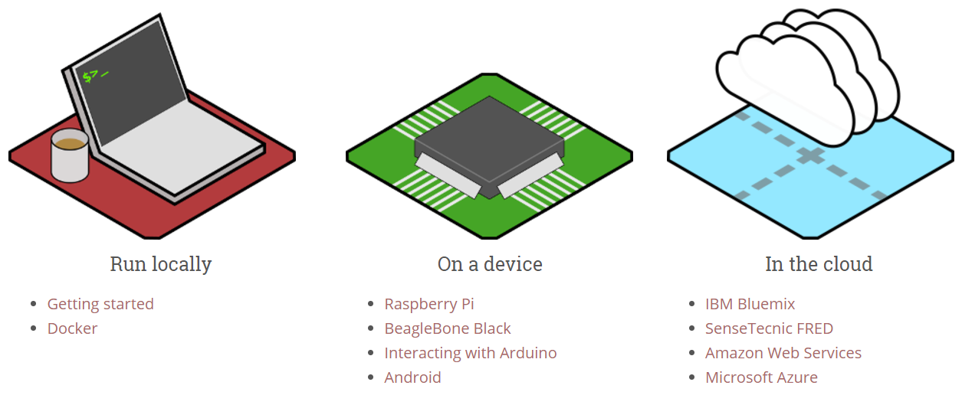
Node-RED environment
Where it can be run:

Slide 9
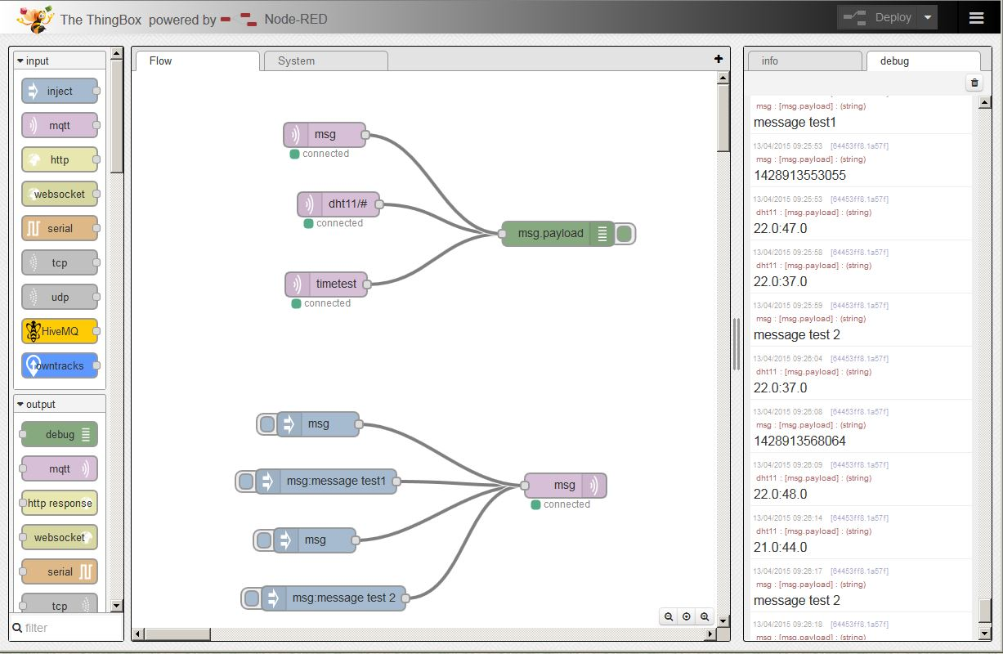
Node-RED GUI

Slide 10
Flow-based programming
Input nodes → only output flows
Execution nodes → both input and output flows
Output nodes → only input flows
Remember to deploy the whole flow!

Slide 11
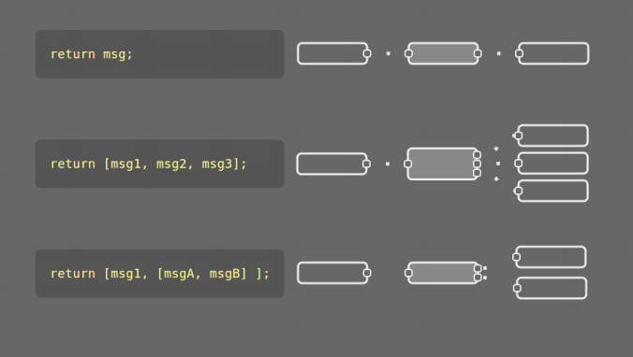
Returning messages

Slide 12


Activities
Hello World
HTTP communication
Simple dashboards
Database
connection
Web interface

Slide 13
Applications
Energy management in smart home/smart building scenarios
Monitoring of business processes and productive
activities in real time (industry 4.0)
Smart retail experiences services and, more in general, any application/service where decisions (either manual or automated) have to be taken based on IoT-generated data

Slide 14

Thanks for your attention! Some questions?
Contact:
alessandra.rizzardi@uninsubria.it

